Slide 1


New York Mets
Midseason Talent Acquisition Strategy
Final Report
Prepared for Don Wedding, GM
August 28th, 2018
New York Mets Analytics
Alexander Booth, Justin Benson, Noah Lieberman, Michael Pallante, Thomas Popeck Spiller

Slide 2
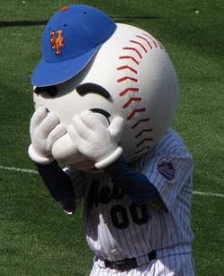

Project Overview
Current State
Recommendation
*As of 8/25/2018
Record:
57-71 (4th place NL East)
Payroll:
$149.6M (12th MLB)
Division:
Braves & Phillies
MiLB Ranking:
28th
Midseason Talent Acquisition Strategy
Goal:
Return to contention in 2019
Midseason Talent Acquisition Strategy
Initial Findings Report

Slide 3
A
Goals & Deliverables
B
Data Sources
CONTENTS
C
Data Overview
D
Exploratory Data Analysis
E
Transformation of Data
F
Modeling
G
Recommendations
H
Dashboard & Mobile App

Slide 4
Project Goals & Deliverables
The goal of the Midseason Talent Acquisition Strategy is to develop predictive modeling capabilities to forecast the likelihood and future production of prospects in other organizations. Using the output, Mets front office management will be enabled to execute trades using the deliverables stated below to return to contention
Objective | Deliverables | What Defines Success
Prospect Value Projections* | Robust data infrastructure of historical minor league performance Predictive models for likelihood to reach majors (e.g., ‘Make it’) and projected career value Final report and trade recommendations | Successful acquisition and organization of data model Accurate testing of model within agreed upon error bounds
Trade Scenario Dashboard* | Dashboard that incorporates current rosters, minor league projections, and facilitates what-if trade scenarios | Usability and successful sign-off from the GM
Mobile Application | Mobile app that enables the analytics team and the GM to visualize results as well as the dashboard on the go | Usability and successful sign-off from the GM
*Note: to be tailored to facilitate trades with the Mariners’ organization, with the ability to go broader for other clubs
Key Project Deliverable
Midseason Talent Acquisition Strategy
Initial Findings Report

Slide 5
Summary of Data Sources
In order to deliver on project goals and deliverables, we plan to develop models based upon the following data sources
Source Name | Description | Acquisition
The Baseball Cube | Major League Data: Player batting, fielding and pitching data from 1865 – 2017 Minor League Data: Player batting and pitching data from 1977- 2017 | Download
Baseball Reference | Minor League Data: Player batting and pitching data from 1977 - 2017 | Web scraping
Fangraphs | Minor League Data: Player batting and pitching data from 2006 - Current | Download
Lahmans’ MLB Database | Major League Data: Player batting, fielding and pitching data from 1865 - 2017 | Download
The Baseball Prospectus | Scouting reports for recent prospects | Web scraping
Primary Data Source
Midseason Talent Acquisition Strategy
Initial Findings Report

Slide 6
Data Overview
Robust Data Infrastructure
Skewed Counting Variables and
Normally Distributed Ratio
Per Game Variables
Takeaways:
Baseball Cube data has 156,589 non-pitcher observations representing 32,566 MiLB players from 1977-2017
Only age and height are missing for a small sample of our population
Takeaways:
Many counting statistics (e.g., AB, H, HR, BB) are skewed right
High correlation between counting statistics and games played
Ratio variables (e.g., Bavg, OBP, SLG, SOpct) display a normal distribution
Correlation between ratio variables and games played is not as significant as it is for counting variables
Takeaways:
Converting to a per game basis will de-skew many of the variables.
Some, like HR may need further adjustment.
Midseason Talent Acquisition Strategy
Initial Findings Report

Slide 7
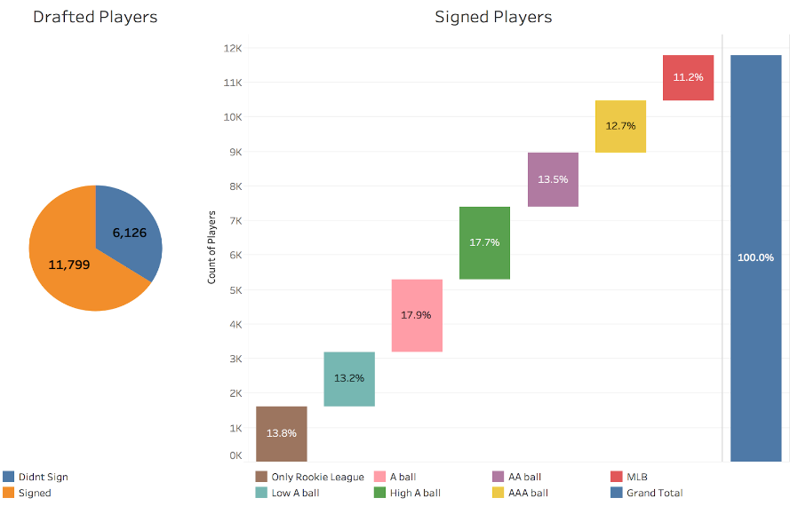
Exploratory Data Analysis Percentage Distribution to Reach MLB Level
Observations
Approximately 2/3 of players drafted in the MLB draft sign with their professional organization
Out of the players that sign, slightly more than 60% of players will never surpass High A ball
Only 11% of players will reach the Major Leagues
34.2%
65.8%
Midseason Talent Acquisition Strategy
Initial Findings Report
Source: Owens, 2017

Slide 8
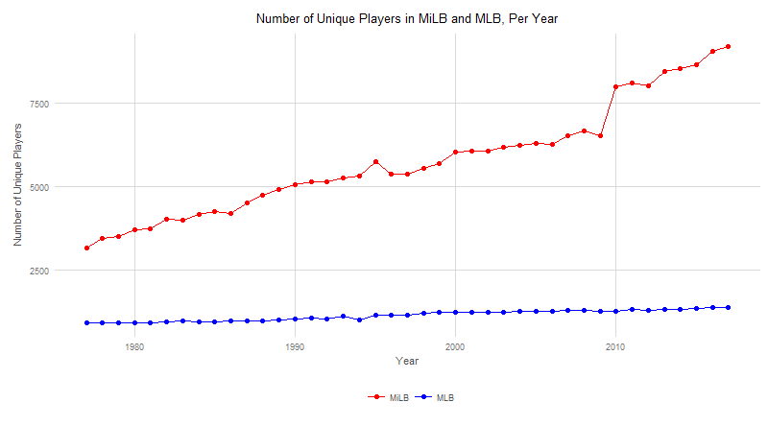
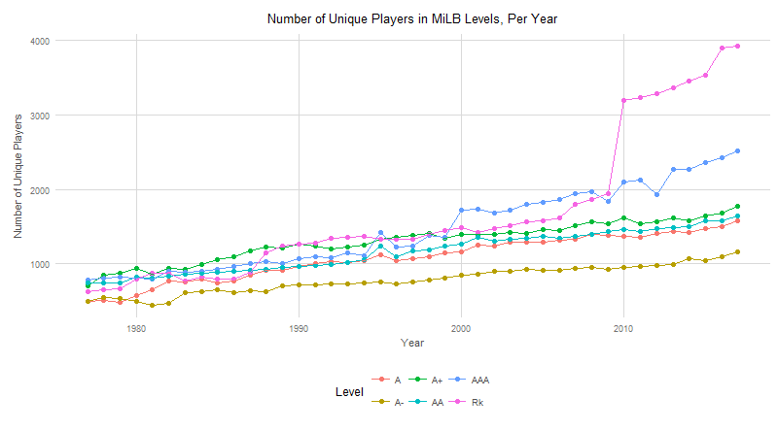
Exploratory Data Analysis Unique Player Counts By Level
Observations
MiLB player growth has significantly outpaced MLB growth (which has remained relatively constant), especially since 2010
The largest increase in MiLB growth has been at the Rookie (Rk) level (driven by the addition of Dominican Summer League statistics)
Midseason Talent Acquisition Strategy
Initial Findings Report
Source: The Baseball Cube

Slide 9
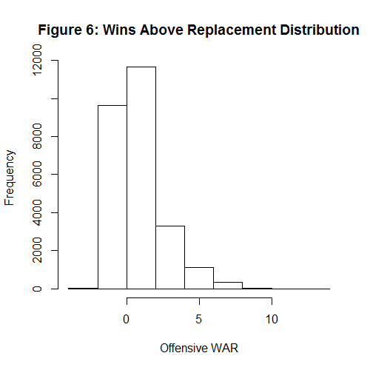
Exploratory Data Analysis Wins Above Replacement (WAR) Distribution
Player Value | WAR | Implied # Players
Scrub | <-.25 | 106
Replacement Player | -0.25 to 0.25 | 228
Role Player | 0.25 to 1 | 117
Solid Starter | 1 to 2.5 | 112
Good Player | 2.5 to 4 | 54
All-Star | 4 to 6.5 | 32
Superstar | 6.5 to 7.5 | 4
MVP | 7.5+ | 2
Observations
Through examination of MLB player WAR values from 1977-2017, we find a skewed left distribution of “Scrubs”, “Replacement Players”, “Role Players”, and “Solid Starters”
On a year-by-year basis, based on the number of players in the MLB, we may imply there will by 32 “All-Star”, 4 “Superstar”, and 2 “MVP” equivalent statistical seasons
Midseason Talent Acquisition Strategy
Initial Findings Report

Slide 10
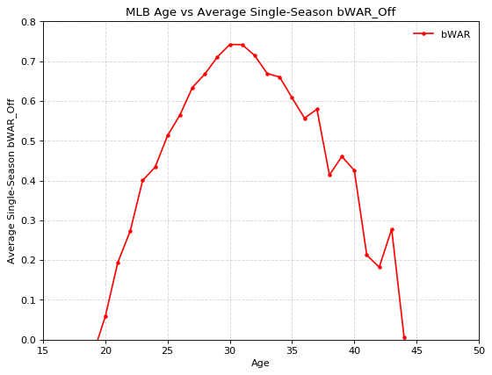
Exploratory Data Analysis Wins Above Replacement (WAR) Distribution
Observations
Further examination of MLB player WAR values from 1977-2017, shows a well defined aging curve. On average, the best single-season in terms of WAR is achieved when a player is 30-31.
With such a stark distribution, we hypothesize that age will play a large role in defining the relationship between whether a player will “make-it” as well as their total career WAR, due simply to access to accumulation.
Midseason Talent Acquisition Strategy
Initial Findings Report

Slide 11
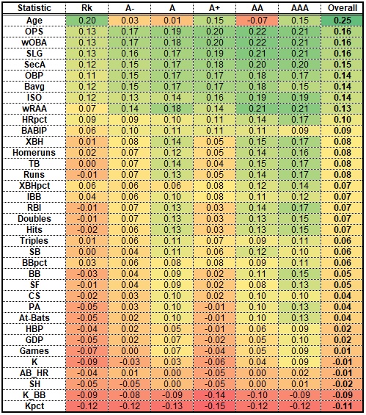
Exploratory Data Analysis Correlation Plots
Correlation (R) to “Made It” (Making it to the Major League Level)
Observations
Age is the strongest predictor of a prospect being called up to the Major Leagues, however it is potentially misleading due to several factors
Among on-field production statistics, there are a few combination offensive statistics (OPS, wOBA, SLG) that are the strongest positive predictors of likelihood to make it to the Majors
Striking out (K_BB, Kpct) is the strongest negative indicator on likelihood to make the Major Leagues
Midseason Talent Acquisition Strategy
Initial Findings Report

Slide 12
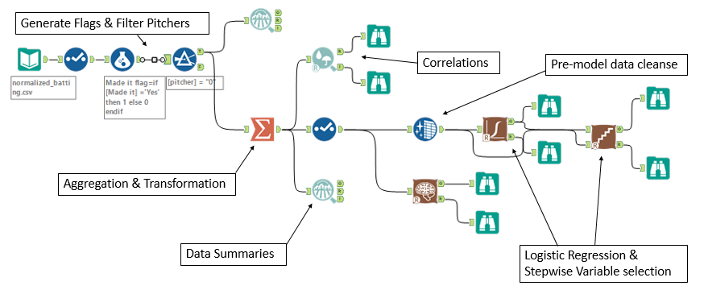
Description of Transformation of Data
Alteryx was used to perform data transformations and quickly create workflows to be scaled within the organization to other MiLB analysis
Midseason Talent Acquisition Strategy
Initial Findings Report

Slide 13
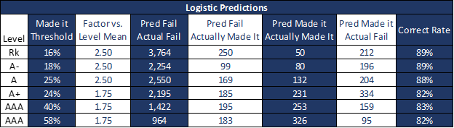
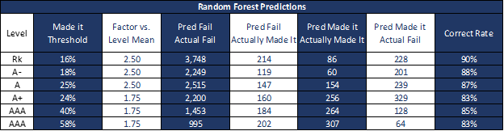
Data Modeling “Made It” Model
The first analytical output created was a “Made It” model to assess the likelihood of players to reach the Major Leagues for at least 3 seasons. Several techniques were tested and ultimately a random forest model proved most accurate
Midseason Talent Acquisition Strategy
Initial Findings Report

Slide 14
Data Modeling “Made It” Model
Midseason Talent Acquisition Strategy
Initial Findings Report

Slide 15
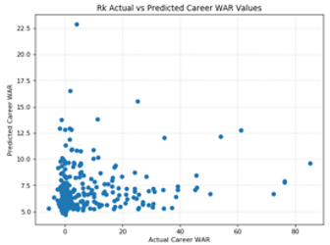
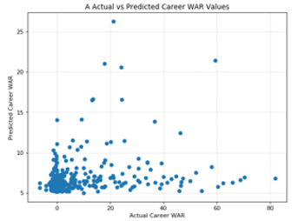
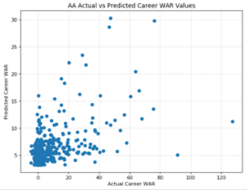
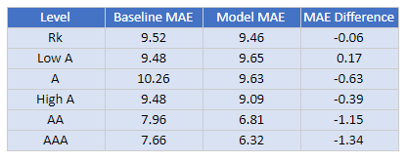
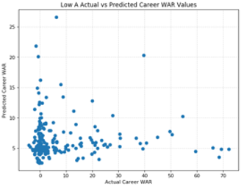
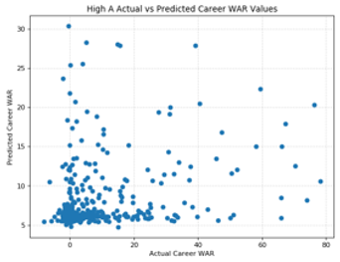
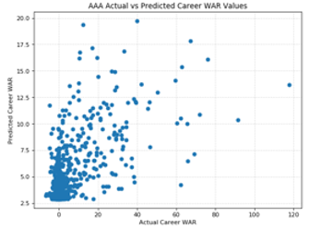
Data Modeling WAR Model
The second analytical output created was a WAR model to assess the future MLB value of Minor League prospects. A gradient boosting model (GBM) provided the best predictions relative to a baseline
Midseason Talent Acquisition Strategy
Initial Findings Report

Slide 16
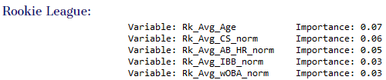
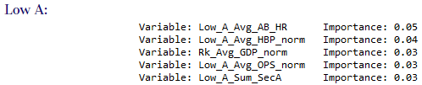
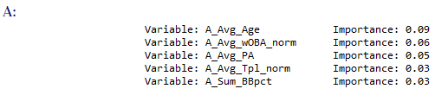
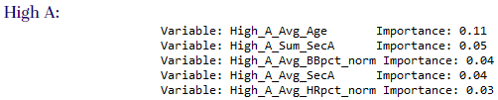
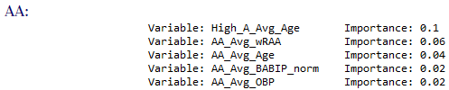
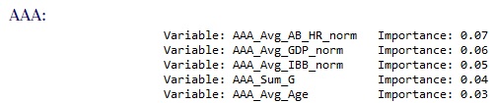
Data Modeling WAR Model
Midseason Talent Acquisition Strategy
Initial Findings Report

Slide 17
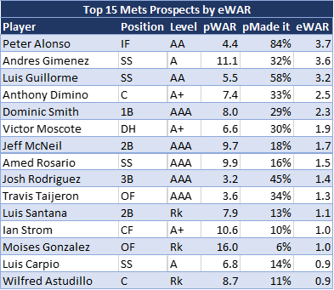
Recommendations Top Mets Prospects within the Organization
Observations
A total future value metric, eWAR, was created based on the “Made It” (pMade it) and WAR (pWAR) models
Dominic Smith, and Jeff McNeil, are the prospects closest having full time career with the Mets organization and necessary parts of the future infield
We should be willing to part with Veteran players in those positions and target prospects at other positions
Midseason Talent Acquisition Strategy
Initial Findings Report
¹Source: MLB Prospect Rankings

Slide 18
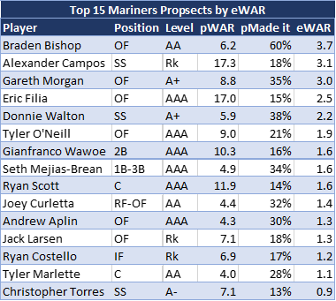
Recommendations Top Mariners Prospects to Target
Observations
A total future value metric, eWAR, was created based on the “Made It” (pMade it) and WAR (pWAR) models
Braden Bishop, Alexander Campos, and Gareth Morgan have the highest eWAR’s within the Mariners organization
However, given the need for close to MLB ready talent, Eric Filia, Tyler O’Neill and Gianfranco Wawoe should merit additional consideration as they are already in AAA
Midseason Talent Acquisition Strategy
Initial Findings Report
¹Source: MLB Prospect Rankings

Slide 19
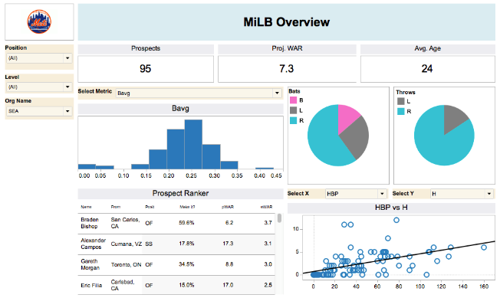
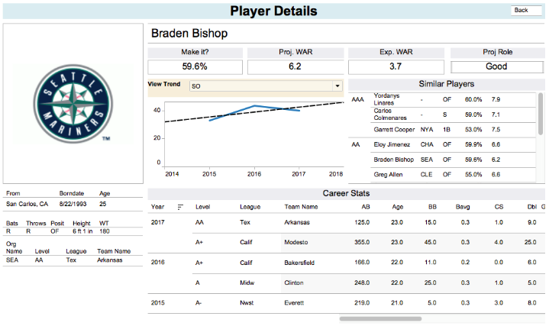
Dashboard & Mobile Application Dashboard
To aid in the management’s use of these models, we have developed a dashboard and mobile application
Midseason Talent Acquisition Strategy
Initial Findings Report

Slide 20
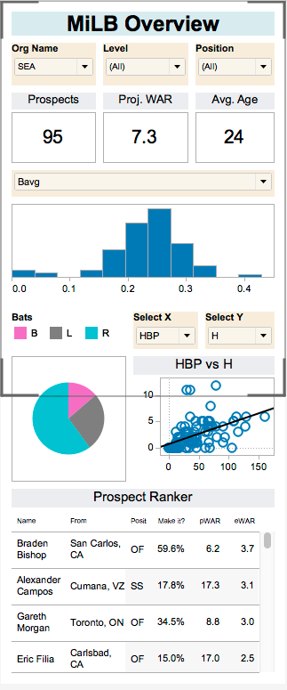
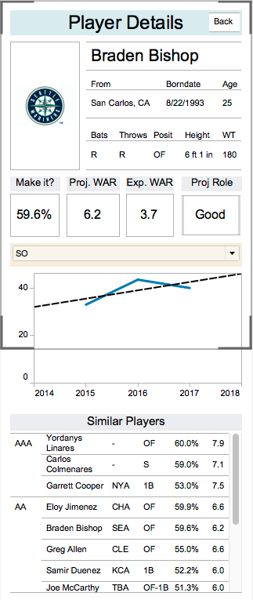
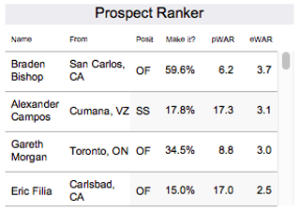
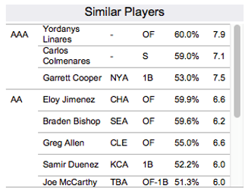
Dashboard & Mobile Application Mobile Application
To aid in the management’s use of these models, we have developed a dashboard and mobile application
Midseason Talent Acquisition Strategy
Initial Findings Report

Slide 21
Q&A

